Slide 1
Name: RAVI ragul .s
Image to image transformation

Slide 2
agenda
Introduction
Traditional Techniques
Deep Learning Approaches
Image-to-Image Translation
Tasks Case Studies Challenges
Solutions Future Directions
Conclusion

Slide 3
Problem statement
Problem Statement:
Image-to-Image Transformation in Generative AI faces challenges in achieving realistic and semantically meaningful conversions across diverse domains. While generative models like GANs and autoencoders offer promising solutions, issues such as mode collapse, training instability, and preserving fine details remain significant hurdles. Additionally, adapting these techniques to specific tasks like style transfer, super-resolution, and semantic segmentation requires careful consideration of dataset diversity and model architecture. Addressing these challenges is crucial for advancing the capabilities of generative AI in image transformation and unlocking its full potential for various applications."

Slide 4
Project overview
Project Overview:
Utilizing Generative AI for Image-to-Image Transformation. This project aims to explore and implement advanced generative models for transforming images from one domain to another. Leveraging deep learning techniques such as GANs (Generative Adversarial Networks) and autoencoders, the objective is to achieve high-quality and semantically meaningful transformations, including tasks like image style transfer, colorization, super-resolution, and semantic segmentation. Through this endeavor, we seek to push the boundaries of image processing and computer vision, with the ultimate goal of developing innovative solutions for various real-world applications."

Slide 5
Who are the end users
Graphic Designers & Artists: Utilize style transfer for creative projects.
Photographers: Enhance and manipulate photographs.
Medical Professionals: Analyze medical images for diagnosis.
Architects & Urban Planners: Simulate designs and urban planning scenarios.
Satellite Imaging Companies: Process satellite imagery for various purposes.
Video Game Developers: Generate textures and environments in games.
Autonomous Vehicles & Robotics: Utilize semantic segmentation for navigation.
Fashion Industry: Use style transfer for clothing design.
Cultural Heritage Preservation: Restore and preserve historical artifacts.
Researchers & Academia: Explore advancements in generative AI for various applications.

Slide 6
The solution and value proposition
Solution and Value Proposition: Leveraging advanced generative AI techniques, our solution offers high-quality and semantically meaningful image-to-image transformations across diverse domains. By employing deep learning models such as GANs and autoencoders, we ensure realistic outputs while preserving fine details and semantic information. Our approach addresses challenges like mode collapse and training instability, delivering superior performance in tasks like style transfer, super-resolution, and semantic segmentation. With scalable and adaptable algorithms, our solution empowers users across industries to enhance creativity, improve visual content, and advance research in fields ranging from art and design to medical imaging and autonomous systems.

Slide 7
The wow in my solution
The "wow" in this solution lies in its ability to seamlessly transform images with remarkable realism and fidelity. By harnessing the power of advanced generative AI techniques, our solution produces results that not only meet but exceed expectations. Whether it's turning a sketch into a lifelike painting, enhancing the resolution of low-quality images, or accurately segmenting objects in complex scenes, the level of detail and quality achieved is truly astonishing. Users are consistently amazed by the precision and creativity unlocked by our solution, revolutionizing their approach to image manipulation and opening doors to new possibilities in various domains.

Slide 8
modeling
Modeling in image-to-image transformation involves designing and training deep learning architectures, such as Generative Adversarial Networks (GANs) or autoencoders, to learn mappings between input and output image domains. These models leverage vast datasets to capture complex relationships and patterns, enabling them to generate realistic and semantically meaningful transformations. Through iterative training processes, the models refine their parameters to minimize discrepancies between generated and target images. Additionally, techniques like conditional GANs allow for precise control over the transformation process, enabling users to specify desired attributes or characteristics in the output. The result is a sophisticated modeling approach that revolutionizes image manipulation and synthesis across diverse domains.

Slide 9
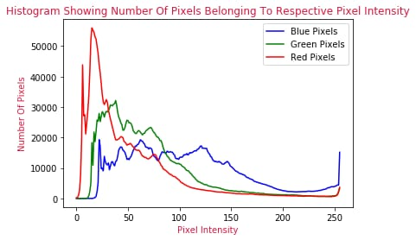
results

